Slide 1
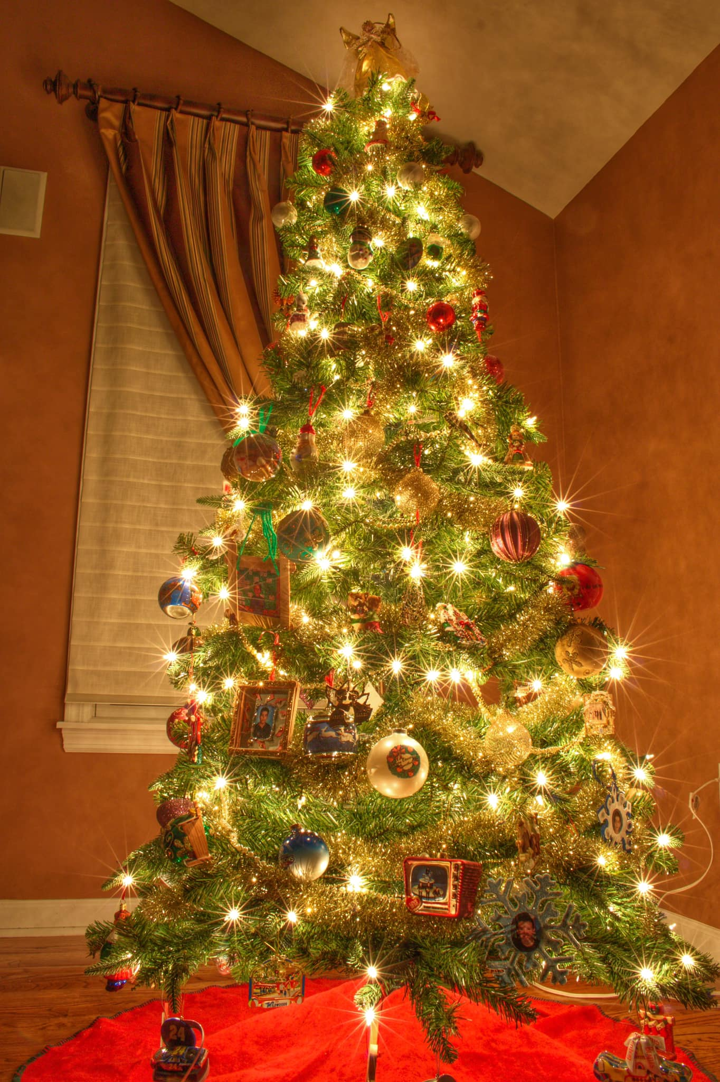
Saddle Brook Mayor’s Youth Group Meeting
Saturday, December 5, 2020

Slide 2
Agenda
Call Meeting To order
Pledge of allegiance
Christmas HOLIDAY decorating contest
New business
Adjourn meeting

Slide 4
CHRISTMAS HOLIDAY DECORATING CONTEST
Christine will send out the list of addresses on Monday, dec. 21st in the evening.
Submit votes to cgenuario@saddlebrooknj.gov by December 26th
Winners will be announced on facebook page on December 26th.

